Slide 1
PDDL+ Planning: Example 2 Planetary Lander

Slide 2

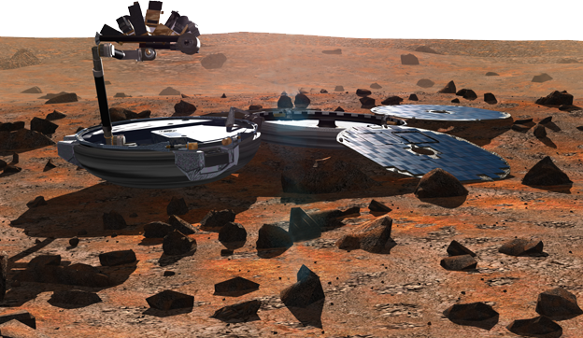
Planetary Lander PDDL+ model [Fox&Long, JAIR 2006]
Prepare Obs 1
charging()
Observe 1
generating()
Fullprepare
Observe 2
4.5
discharging()
Prepare Obs 2
Processes
PDDL+
Durative Action
Battery
(%)
Supply
(energy)
Demand
(energy)
Notes:
As a case study, we considered the Planetary Lander Domain.
We have a Solar-powered lander.
Basically, it must perform two observation actions, called Observe1 and Observe2. (animazione)
However, before making each observation, it must perform the corresponding preparation task, called prepareObs1 and prepareObs2, respectively. (animazione)
Alternatively, the probe may choose to perform a cumulative preparation task for both observations by executing the single long action fullPrepare. The shorter actions have higher power requirements than the single preparation action.
(animazione)
During the plan execution, Beagle can use the energy generated by the sunlight (process generating) to perform actions immediately or use it to charge the battery (process charge). If no energy is available Beagle uses the battery ones.

Slide 3


4.5
4.6
4.7
4.8
4.9
5.0
Battery
(%)
Notes:
In the general theory of universal planning, the concept of start state is not present. However, the concept of reachable state implies such a start state. In particolar, this is very important for model checking algorithms. In other words, we need to start-up the universal planning with a set of start states, that we call start state cloud.
In this experiment, we generated the start state cloud by varying the initial battery charge and the daytime. In fact, these variables define the environmental conditions.

Slide 4
Planetary Lander: PDDL+ domain
Use events to model discrete changes in the world...
(:event daybreak
:parameters ()
:precondition (and (not (day))
(>= (daytime) 0))
:effect (day))
(:event nightfall
:parameters ()
:precondition (and (day) (>= (daytime) (dusk)))
:effect (and (assign (daytime) (- (dawn)) )
(not (day))))

Slide 5
Planetary Lander: PDDL+ domain
Use events to model discrete changes in the world...
...then use processes to model the continuous change due to the triggered events
(:event daybreak
:parameters ()
:precondition (and (not (day))
(>= (daytime) 0))
:effect (day))
(:event nightfall
:parameters ()
:precondition (and (day) (>= (daytime) (dusk)))
:effect (and (assign (daytime) (- (dawn)) )
(not (day))))
(:process generating
:parameters ()
:precondition (day)
:effect (and (increase (supply)
(* #t (* (* (solar_const) (daytime))
(increase (daytime) (* #t 1)))
)

Slide 6
Planetary Lander: PDDL+ domain
Use events to model discrete changes in the world...
...then use processes to model the continuous change due to the triggered events
(:event daybreak
:parameters ()
:precondition (and (not (day))
(>= (daytime) 0))
:effect (day))
(:event nightfall
:parameters ()
:precondition (and (day) (>= (daytime) (dusk)))
:effect (and (assign (daytime) (- (dawn)) )
(not (day))))
(:process generating
:parameters ()
:precondition (day)
:effect (and (increase (supply)
(* #t (* (* (solar_const) (daytime))
(increase (daytime) (* #t 1)))
)

Slide 7
Planetary Lander: PDDL+ domain
Use events to model discrete changes in the world...
...then use processes to model the continuous change due to the triggered events
(:event daybreak
:parameters ()
:precondition (and (not (day))
(>= (daytime) 0))
:effect (day))
(:event nightfall
:parameters ()
:precondition (and (day) (>= (daytime) (dusk)))
:effect (and (assign (daytime) (- (dawn)) )
(not (day))))
(:process generating
:parameters ()
:precondition (day)
:effect (and (increase (supply)
(* #t (* (* (solar_const) (daytime))
(increase (daytime) (* #t 1)))
)

Slide 8
Planetary Lander: PDDL+ domain
Use events to model discrete changes in the world...
...then use processes to model the continuous change due to the triggered events
(:event daybreak
:parameters ()
:precondition (and (not (day))
(>= (daytime) 0))
:effect (day))
(:event nightfall
:parameters ()
:precondition (and (day) (>= (daytime) (dusk)))
:effect (and (assign (daytime) (- (dawn)) )
(not (day))))
(:process generating
:parameters ()
:precondition (day)
:effect (and (increase (supply)
(* #t (* (solar_const) (daytime))))
(increase (daytime) (* #t 1)))
)
(:process night_operations
:parameters ()
:precondition (not (day))
:effect (and (decrease (soc) (* #t (heater_rate))) (increase (daytime) (* #t 1)))
)

Slide 9
Planetary Lander: PDDL+ domain
Use events to model discrete changes in the world...
...then use processes to model the continuous change due to the triggered events
(:event daybreak
:parameters ()
:precondition (and (not (day))
(>= (daytime) 0))
:effect (day))
(:event nightfall
:parameters ()
:precondition (and (day) (>= (daytime) (dusk)))
:effect (and (assign (daytime) (- (dawn)) )
(not (day))))
(:process generating
:parameters ()
:precondition (day)
:effect (and (increase (supply)
(* #t (* (solar_const) (daytime))))
(increase (daytime) (* #t 1)))
)
(:process night_operations
:parameters ()
:precondition (not (day))
:effect (and (decrease (soc) (* #t (heater_rate))) (increase (daytime) (* #t 1)))
)

Slide 10
Planetary Lander: PDDL+ domain
Processes allow an easy modelling of concurrency and interactions...
(:process charging
:parameters ()
:precondition (and (day)
(< (demand) (supply)))
:effect (and (increase (soc)
(* #t (* (beta) (- (supply) (demand)))
)
(:process generating
:parameters ()
:precondition (day)
:effect (and (increase (supply)
(* #t (* (solar_const) (daytime))))
(increase (daytime) (* #t 1)))
)
(:process night_operations
:parameters ()
:precondition (not (day))
:effect (and (decrease (soc) (* #t (heater_rate))) (increase (daytime) (* #t 1)))
)

Slide 11
Planetary Lander: PDDL+ domain
Processes allow an easy modelling of concurrency and interactions...
(:process charging
:parameters ()
:precondition (and (day)
(< (demand) (supply)))
:effect (and (increase (soc)
(* #t (* (beta) (- (supply) (demand)))
)
(:process discharging
:parameters ()
:precondition (> (demand) (supply))
:effect (decrease (soc) (* #t (- (demand) (supply))))
)
(:process generating
:parameters ()
:precondition (day)
:effect (and (increase (supply)
(* #t (* (solar_const) (daytime))))
(increase (daytime) (* #t 1)))
)
(:process night_operations
:parameters ()
:precondition (not (day))
:effect (and (decrease (soc) (* #t (heater_rate))) (increase (daytime) (* #t 1)))
)

Slide 12
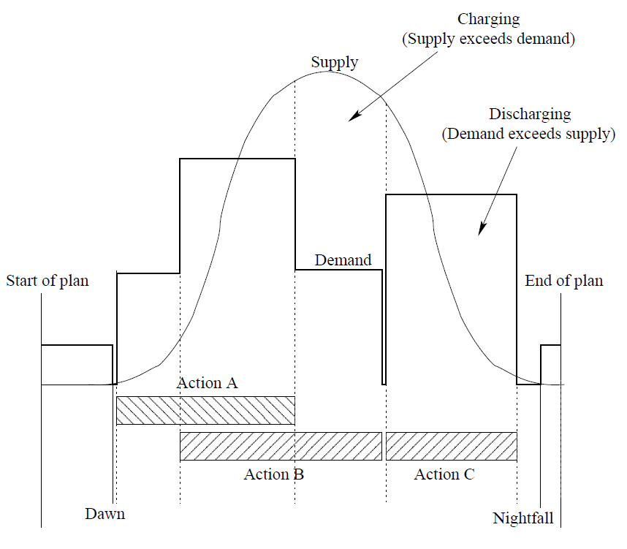
Planetary Lander: PDDL+ domain

Slide 13
Planetary Lander: PDDL+ domain
And now let’s see what the planner can choose to do...
(:durative-action fullPrepare
:parameters ()
:duration (= ?duration fullprepare_durtime)
:condition (and (at start (available unit))
(over all (> (soc) (safelevel))))
:effect (and (at start (not (available unit))) (at end (available unit))
(at start (increase (demand) (A_rate))) (at end (decrease (demand) (A_rate)))
(at end (readyForObs1)) (at end (readyForObs2))))

Slide 14
Planetary Lander: PDDL+ domain
And now let’s see what the planner can choose to do...
(:durative-action fullPrepare
:parameters ()
:duration (= ?duration fullprepare_durtime)
:condition (and (at start (available unit))
(over all (> (soc) (safelevel))))
:effect (and (at start (not (available unit))) (at end (available unit))
(at start (increase (demand) (A_rate))) (at end (decrease (demand) (A_rate)))
(at end (readyForObs1)) (at end (readyForObs2))))
Note that the change in the demand
here is a discrete change !
(:durative-action prepareObs1
:parameters ()
:duration (= ?duration (prepobs1_durtime))
:condition (and (at start (available unit))
(over all (> (soc) (safelevel))))
:effect (and (at start (not (available unit)))
(at end (available unit))
(at start (increase (demand) (B_rate)))
(at end (decrease (demand) (B_rate)))
(at end (readyForObs1))))
(:durative-action prepareObs2
:parameters ()
:duration (= ?duration (prepobs2_durtime))
:condition (and (at start (available unit))
(over all (> (soc) (safelevel))))
:effect (and (at start (not (available unit)))
(at end (available unit))
(at start (increase (demand) (C_rate)))
(at end (decrease (demand) (C_rate)))
(at end (readyForObs2))))

Slide 15
Planetary Lander: PDDL+ domain
And now let’s see what the planner can choose to do...
(:durative-action fullPrepare
:parameters ()
:duration (= ?duration fullprepare_durtime)
:condition (and (at start (available unit))
(over all (> (soc) (safelevel))))
:effect (and (at start (not (available unit))) (at end (available unit))
(at start (increase (demand) (A_rate))) (at end (decrease (demand) (A_rate)))
(at end (readyForObs1)) (at end (readyForObs2))))
These actions cannot be executed
in parallel
(:durative-action prepareObs1
:parameters ()
:duration (= ?duration (prepobs1_durtime))
:condition (and (at start (available unit))
(over all (> (soc) (safelevel))))
:effect (and (at start (not (available unit)))
(at end (available unit))
(at start (increase (demand) (B_rate)))
(at end (decrease (demand) (B_rate)))
(at end (readyForObs1))))
(:durative-action prepareObs2
:parameters ()
:duration (= ?duration (prepobs2_durtime))
:condition (and (at start (available unit))
(over all (> (soc) (safelevel))))
:effect (and (at start (not (available unit)))
(at end (available unit))
(at start (increase (demand) (C_rate)))
(at end (decrease (demand) (C_rate)))
(at end (readyForObs2))))

Slide 16
Planetary Lander: PDDL+ domain
And now let’s see what the planner can choose to do...
(:durative-action fullPrepare
:parameters ()
:duration (= ?duration 5.0)
:condition (and (at start (available unit))
(over all (> (soc) (safelevel))))
:effect (and (at start (not (available unit))) (at end (available unit))
(at start (increase (demand) 4.0)) (at end (decrease (demand) 4.0))
(at end (readyForObs1)) (at end (readyForObs2))))
(:durative-action prepareObs1
:parameters ()
:duration (= ?duration 2.0)
:condition (and (at start (available unit))
(over all (> (soc) (safelevel))))
:effect (and (at start (not (available unit)))
(at end (available unit))
(at start (increase (demand) 2.4))
(at end (decrease (demand) (B_rate)))
(at end (readyForObs1))))
(:durative-action prepareObs2
:parameters ()
:duration (= ?duration 2.0)
:condition (and (at start (available unit))
(over all (> (soc) (safelevel))))
:effect (and (at start (not (available unit)))
(at end (available unit))
(at start (increase (demand) 2.9))
(at end (decrease (demand) (C_rate)))
(at end (readyForObs2))))

Slide 17
Planetary Lander: PDDL+ domain
Now we are ready to make the observations...
(:durative-action observe1
:parameters ()
:duration (= ?duration obs1Time)
:condition (and (at start (available unit))
(at start (readyForObs1))
(over all (> (soc) (safelevel))))
:effect (and (at start (not (available unit))) (at end (available unit))
(at start (increase (demand) (obs1-rate)))
(at end (decrease (demand) (obs1-rate)))
(at end (gotObs1))))
(:durative-action observe2
:parameters ()
:duration (= ?duration obs2Time)
:condition (and (at start (available unit))
(at start (readyForObs2))
(over all (> (soc) (safelevel))))
:effect (and (at start (not (available unit))) (at end (available unit))
(at start (increase (demand) (obs2-rate)))
(at end (decrease (demand) (obs2-rate)))
(at end (gotObs2))))

Slide 18
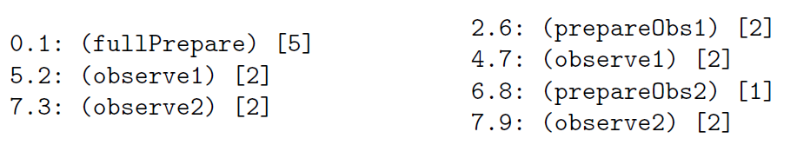
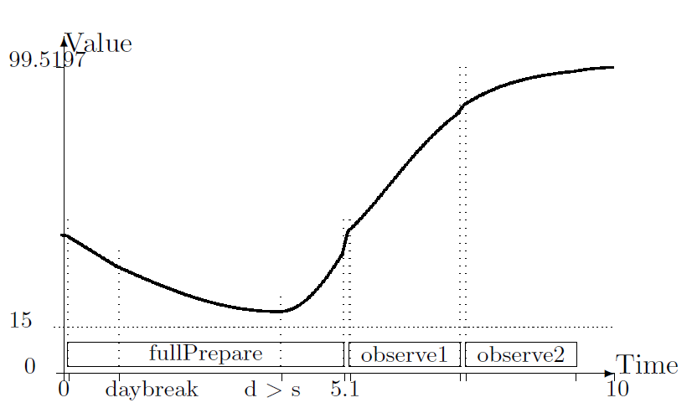
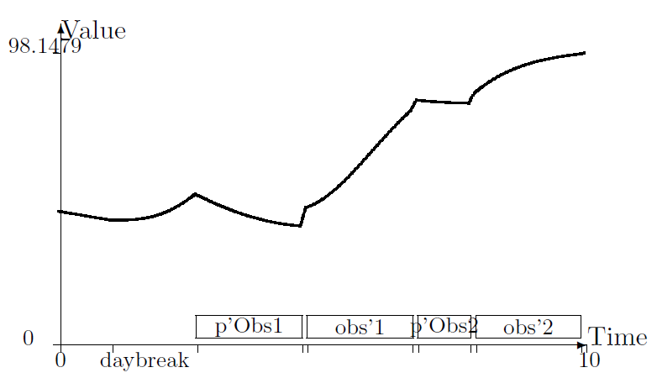

Battery state of charge
Notes:
The last step is the evaluation of the generated plans.
To this end, we used the well-known validator VAL.
Moreover, to estimate the precision of the plans, the tool compares the variables values computed by VAL during the validation process with the values computed during the generation process.
The table shows the normalized root mean square error for the nonlinear variables involved in the problem.
Note that, the average values are small, so the chosen discretization is good.

